Slide 1
Capstone Design
Team 3
20163704
20161344
20164245
Park JuHyeon
Heo JeongWoo
Hong Jin

Slide 2
Contents
1.
Feedback
Progress
Schedule
Q&A
2.
3.
4.

Slide 3
1.
Q&A Feedback

Slide 4
2.
Progress

Slide 5
2.1
UI

Slide 6

2
Progress
UI – Heo Jeongwoo & Hong Jin
Simple UI

Slide 7

2
Progress
UI - Heo Jeongwoo & Hong Jin
Apply CSS Code
background-color:#F5D6C6;

Slide 8
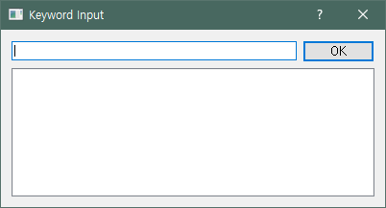
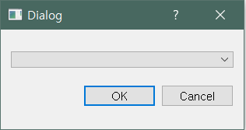
2
Progress
UI - Heo Jeongwoo & Hong Jin
Lasso Tool

Slide 9
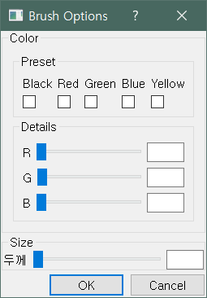
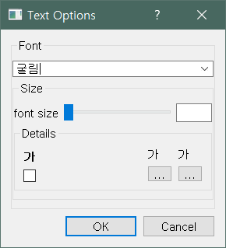
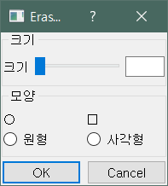
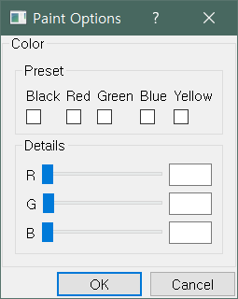
2
Progress
UI - Heo Jeongwoo & Hong Jin
Bursh tool
Text tool
Eraser tool
Paint tool

Slide 10
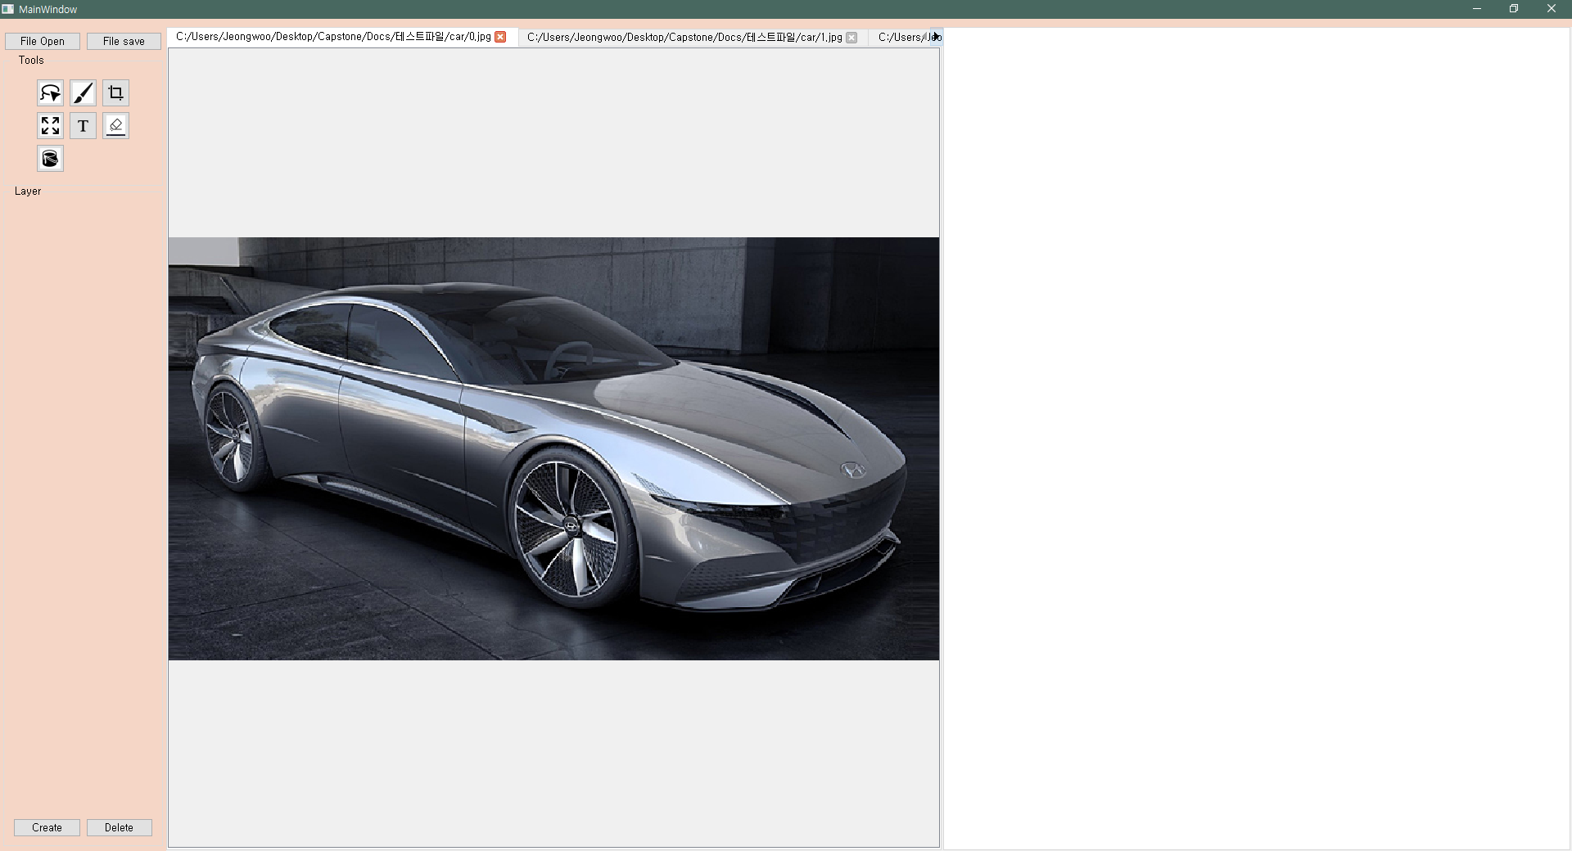
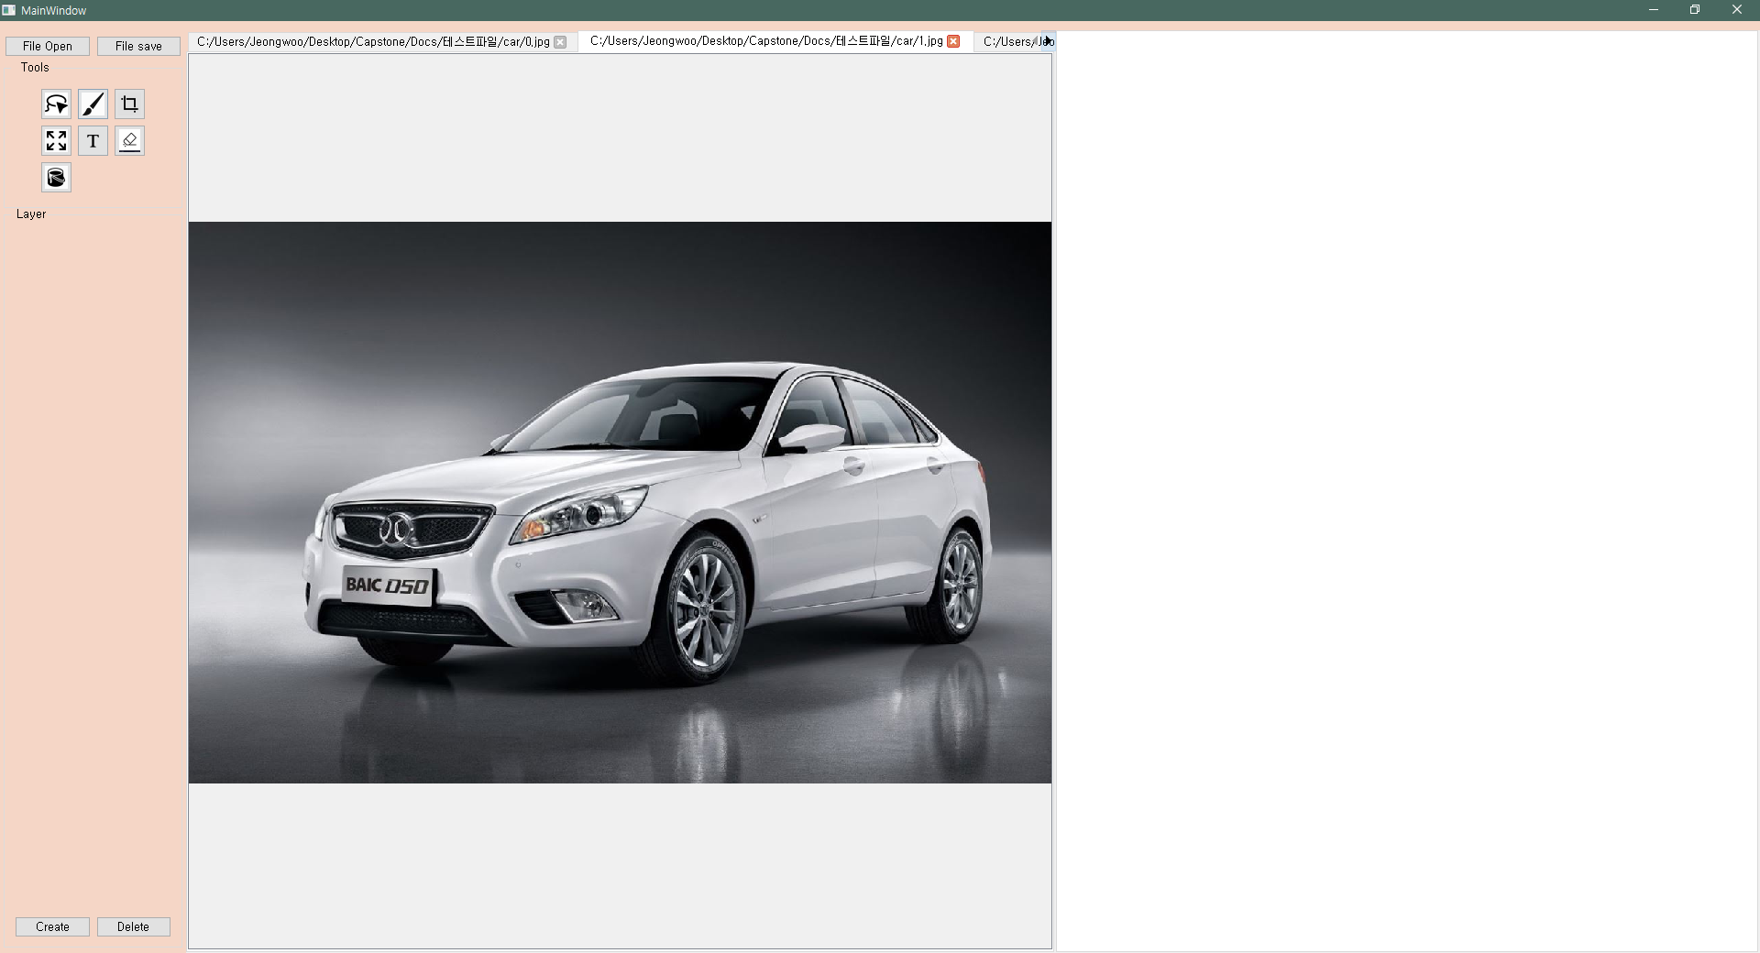
2
Progress
Basic Functions – Heo Jeongwoo & Hong Jin
File Open

Slide 11
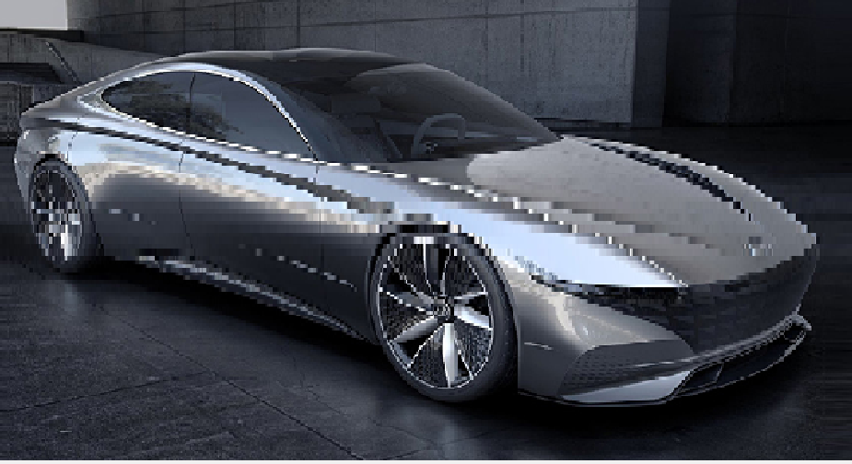
2
Progress
Basic Functions – Heo Jeongwoo & Hong Jin
Resolution degradation
Original Image
Degraded image
When window maximize & minimize repeatedly, the image resolution degradation is occurred
How to Solve : Do not update pixel data when scaling

Slide 12
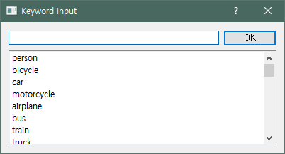
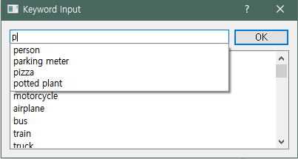
2
Progress
Basic Functions – Heo Jeongwoo & Hong Jin
Keyword Recommendation

Slide 13
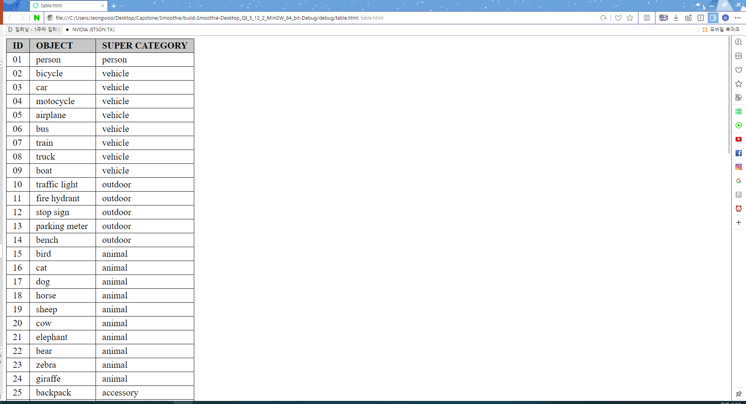
2
Progress
Basic Functions – Heo Jeongwoo & Hong Jin
Keyword Recommendation
click

Slide 14
2.2
Image Segmentation

Slide 15
2
Progress
AWS – Park Juhyeon
Using ‘AWS Deep Learning AMI’(DLAMI)
Instance Type
P2.xlarge – 1$ per hour (4 CPU, 12GiB VRAM)
P3.xlarge – 4$ per hour(8 CPU, 16GiB VRAM)
We need to sign up for using DLAMI instance

Slide 16
2
Progress
AWS – Park Juhyeon
Problems
IP changes every time instance is turned on

Slide 17
2
Progress
Deep Learning Environment– Park Juhyeon
Tensorflow
cuda9.0
Keras 2
Python 3.5
Anaconda 3
Jupyter Notebook
etc…

Slide 18
2
Progress
Preparing for Test– Park Juhyeon
Trained Data: MS-COCO 2017
Test Image set
Provided test image set in MS-COCO 2017 result is obvious
So, we decided to use the randomly selected raw image test set
About apple, backpack, bird, car, cat, chair, dog, person, tennis racket, tv
Total 10 classes

Slide 19
2
Progress
Test Result(Apple)– Park Juhyeon
General apples generally have good detection and segmentation
However, an artificial apple model or an apples in a picture are not recognizable
➔ We guess that trained apple data is based on real apple images
Low resolution images cannot detect well
➔ Need to having a resolution higher than a certain level

Slide 20
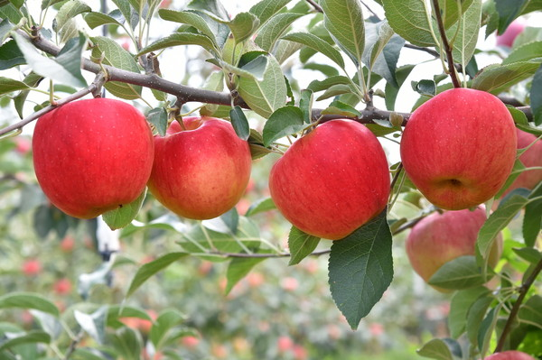
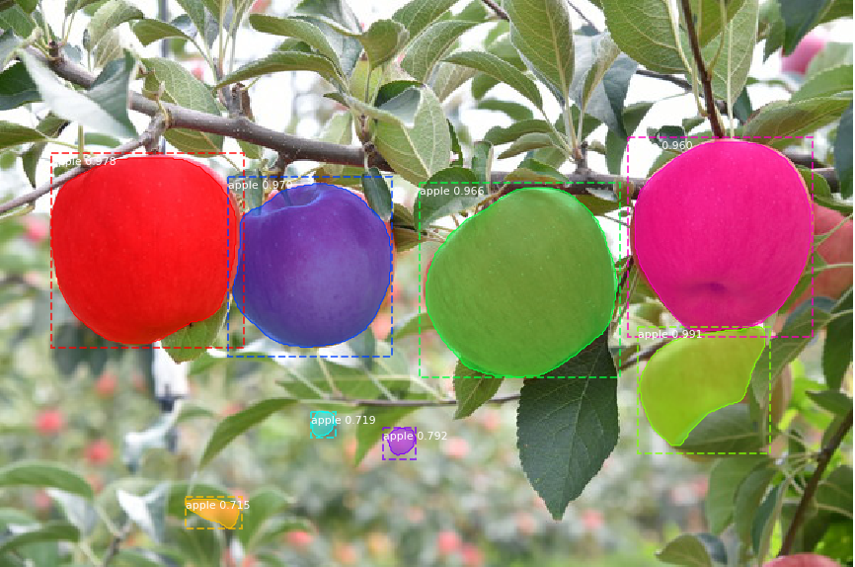
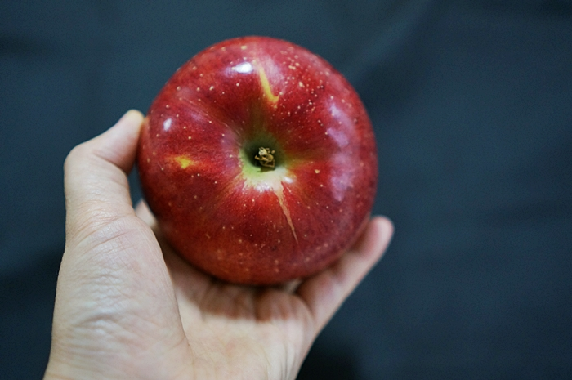
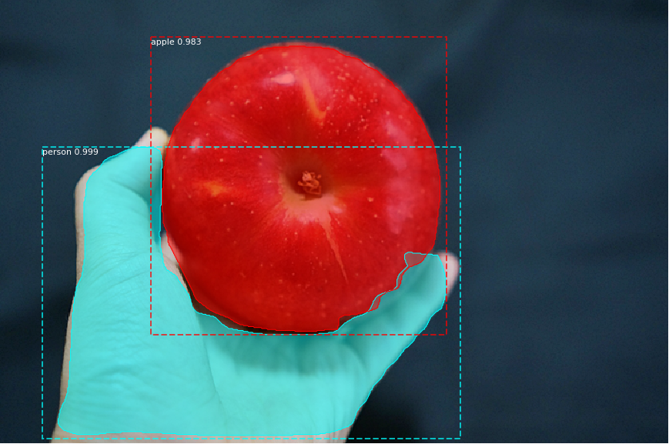
2
Progress
Test Result(Apple)– Park Juhyeon
Best case

Slide 21
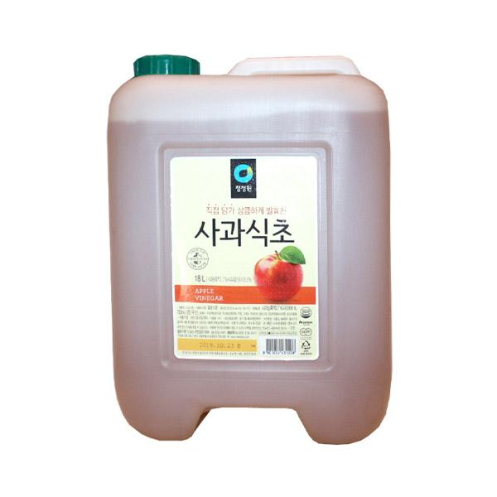
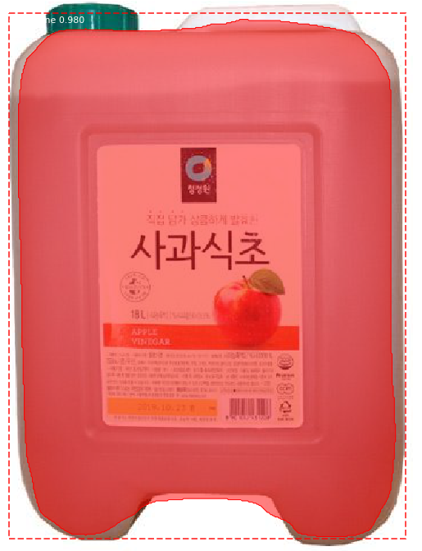
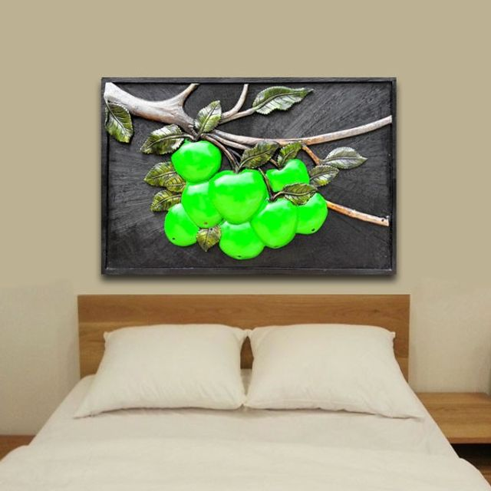
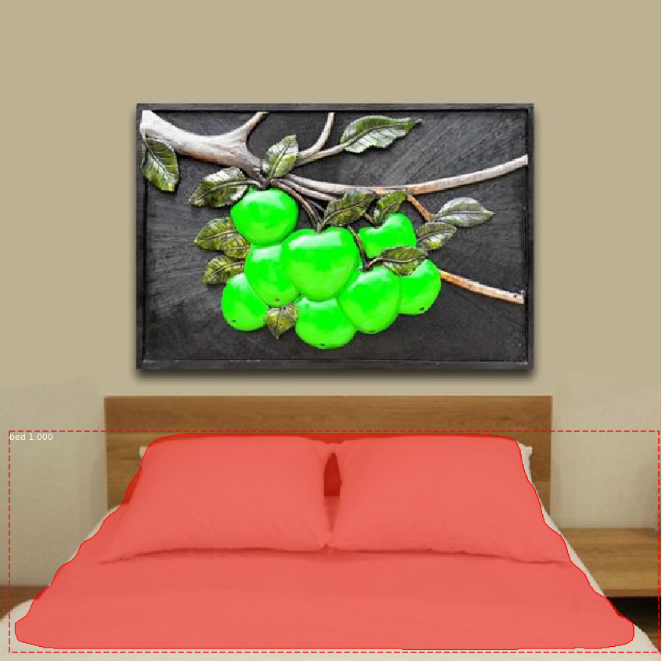
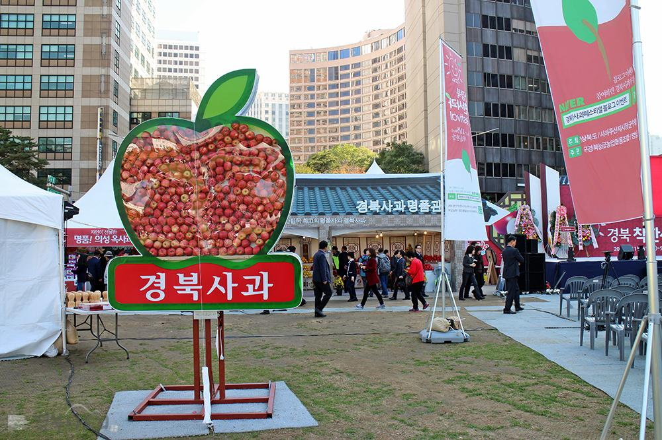
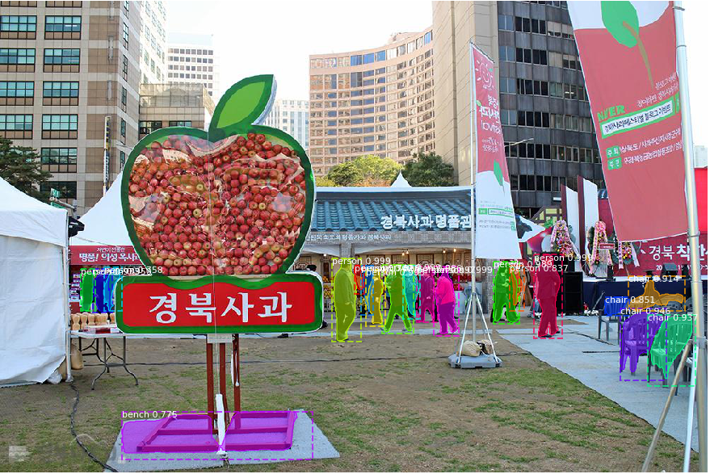
2
Progress
Test Result(Apple)– Park Juhyeon
Bad case

Slide 22
2
Progress
Test Result(Cat)– Park Juhyeon
Overall detection is smooth, but segmentation is not perfect
Especially ear, tail
Low resolution images cannot detect well
➔ Need to having a resolution higher than a certain level

Slide 23
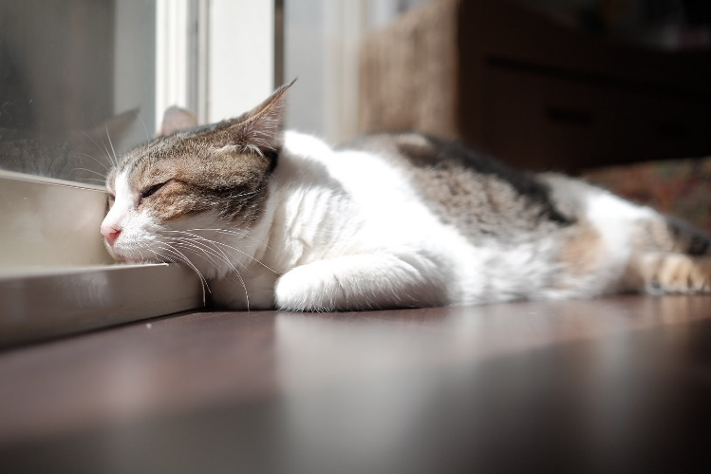
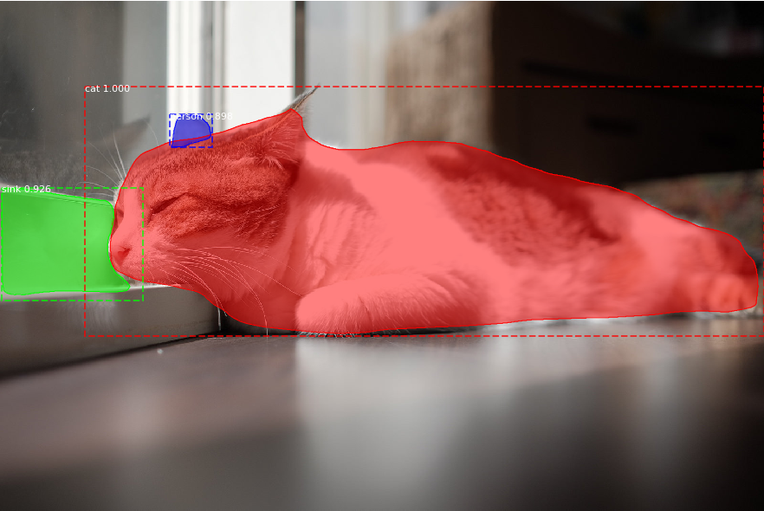
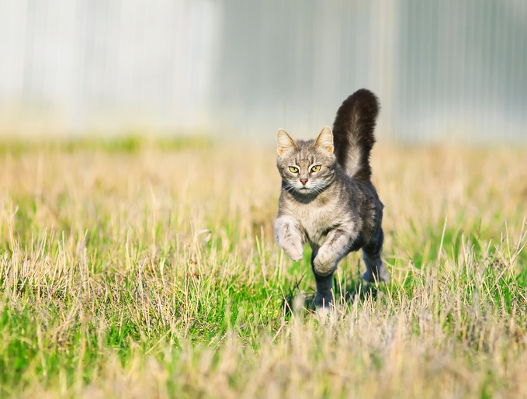
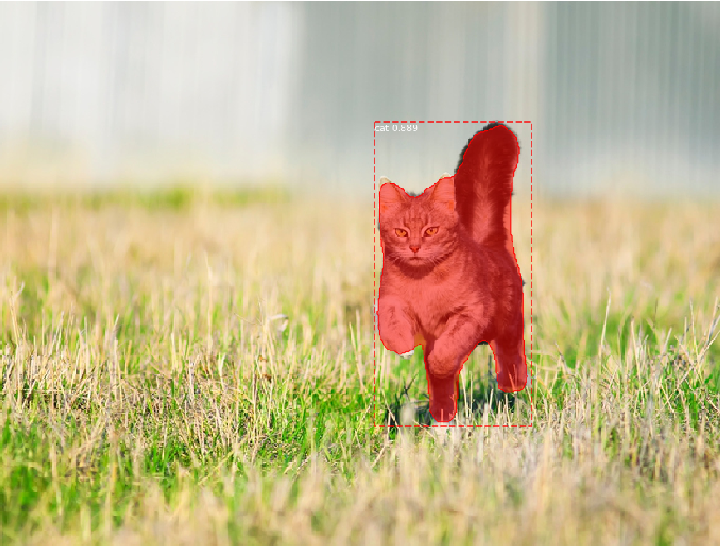
2
Progress
Test Result(Cat)– Park Juhyeon
Best case

Slide 24
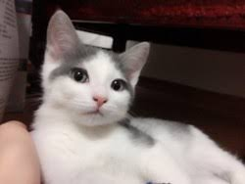
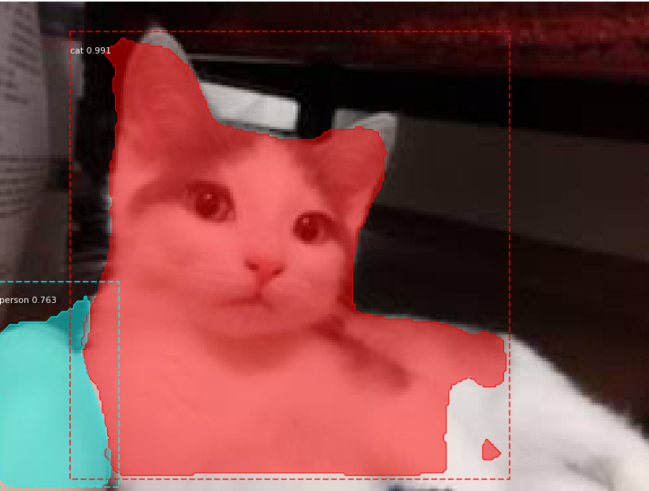
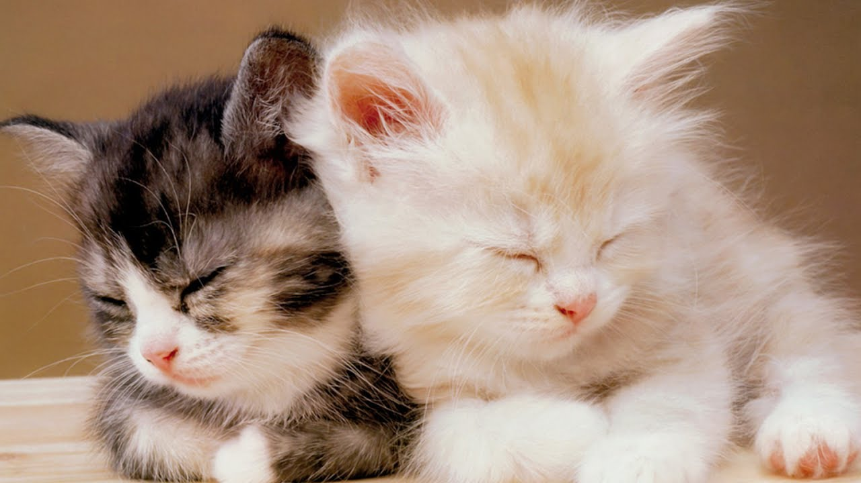
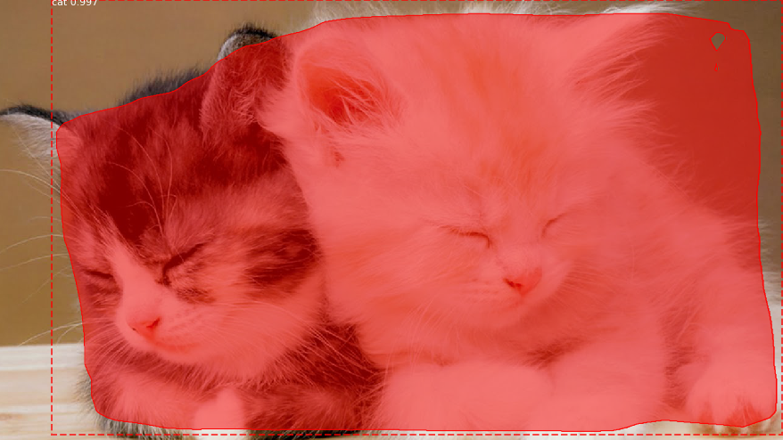
2
Progress
Test Result(Cat)– Park Juhyeon
Bad case

Slide 25
2
Progress
Test Result(Dog)– Park Juhyeon
The best of the tested classes.
But elaborate segmentation is lack
Low resolution images cannot detect well
➔ Need to having a resolution higher than a certain level

Slide 26
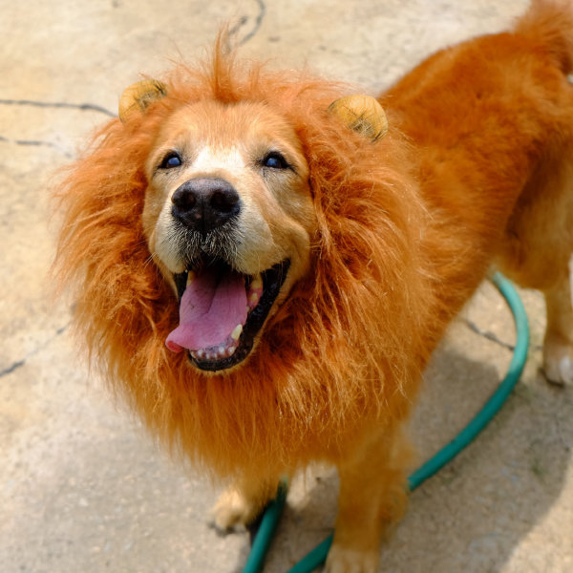
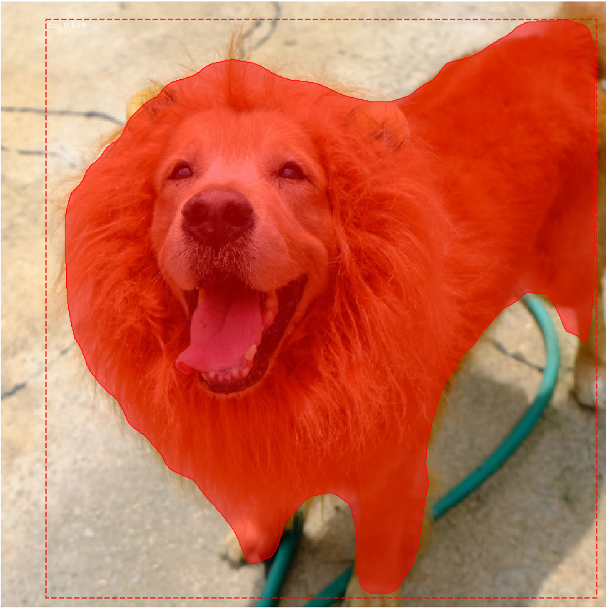
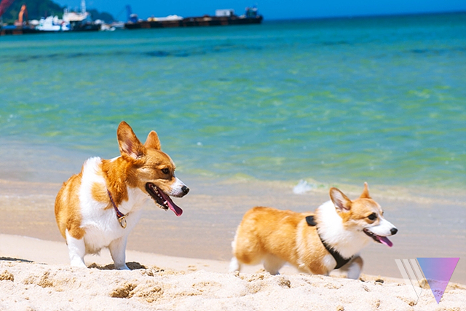
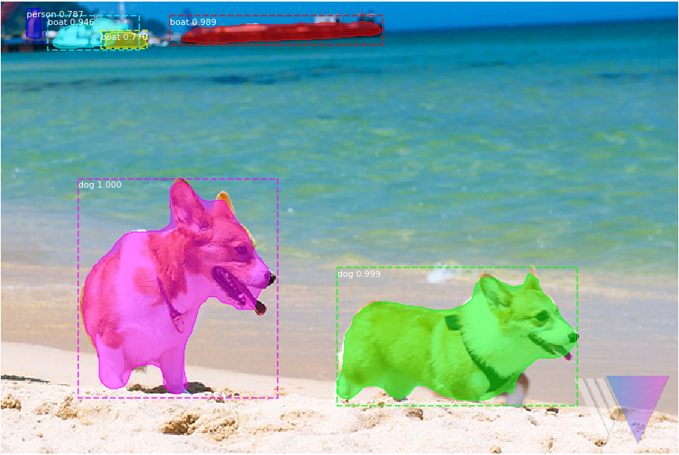
2
Progress
Test Result(Dog)– Park Juhyeon
Best case

Slide 27
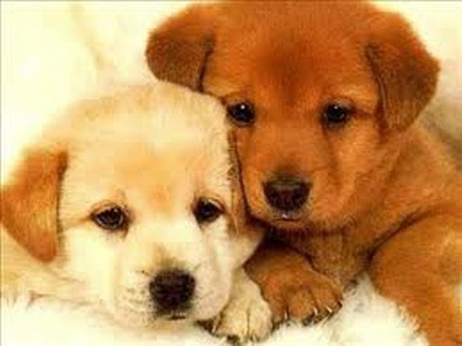
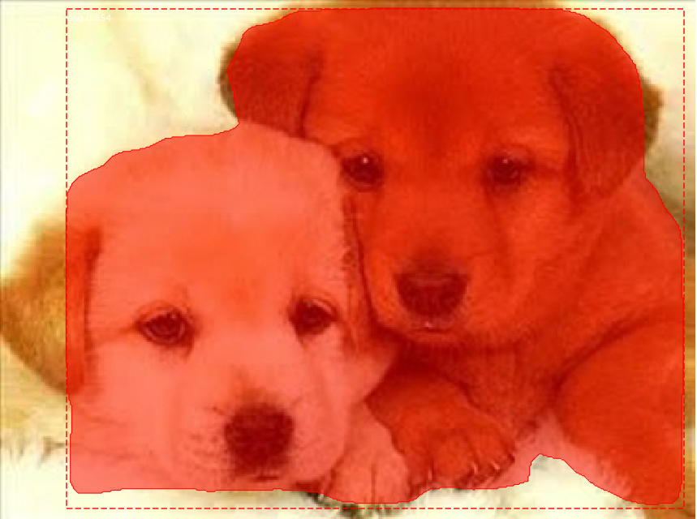
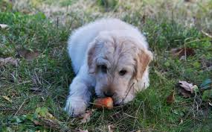
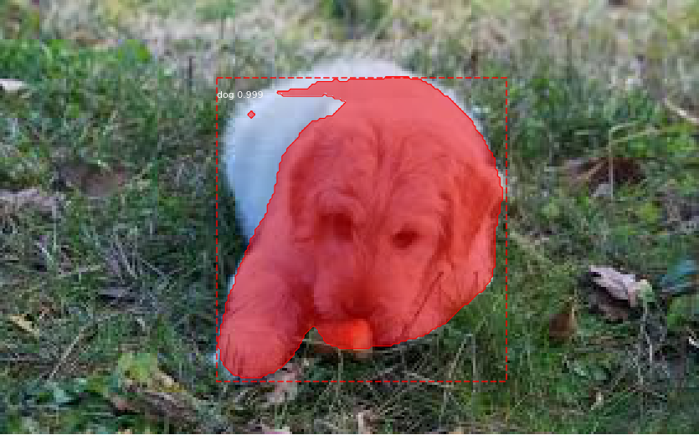
2
Progress
Test Result(Dog)– Park Juhyeon
Bad case

Slide 28
2
Progress
Test Result(Person)– Park Juhyeon
Overall detection, segmentation is smooth, but instantiation elaboration is lack
Low resolution images cannot detect well
➔ Need to having a resolution higher than a certain level

Slide 29
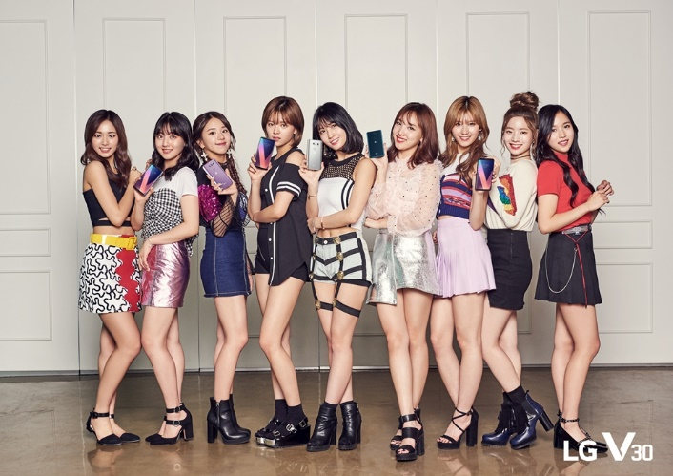
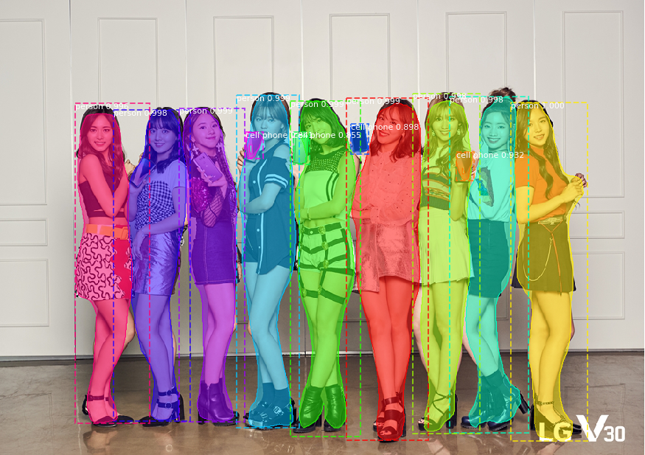
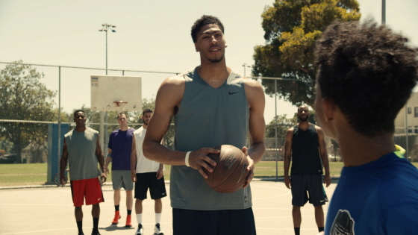
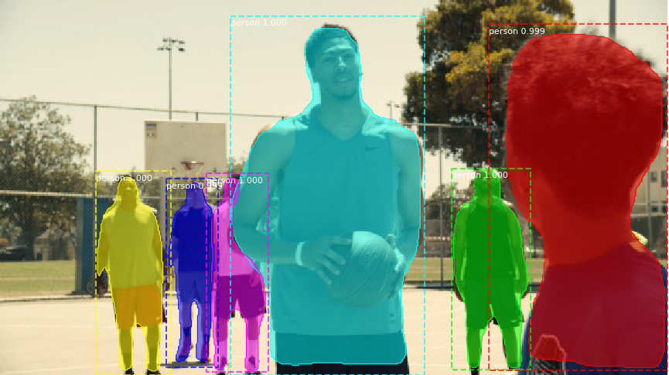
2
Progress
Test Result(Person)– Park Juhyeon
Best case

Slide 30
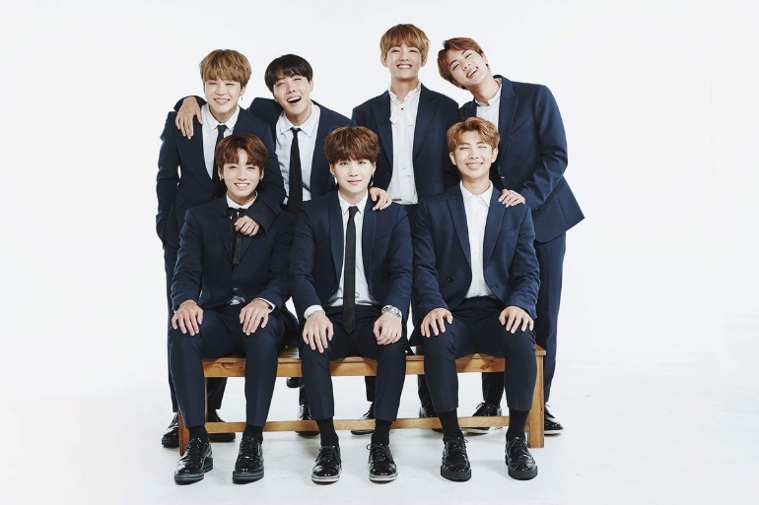
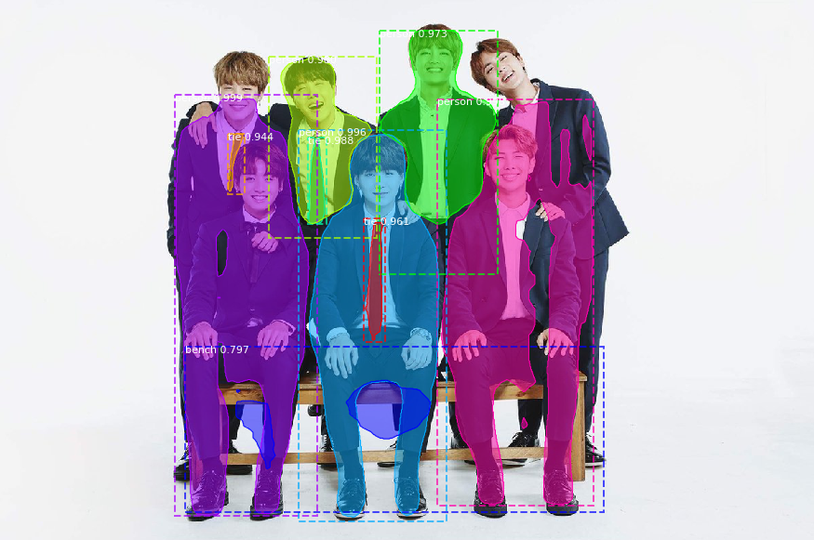
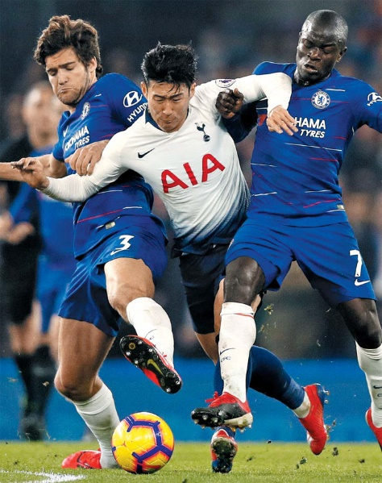
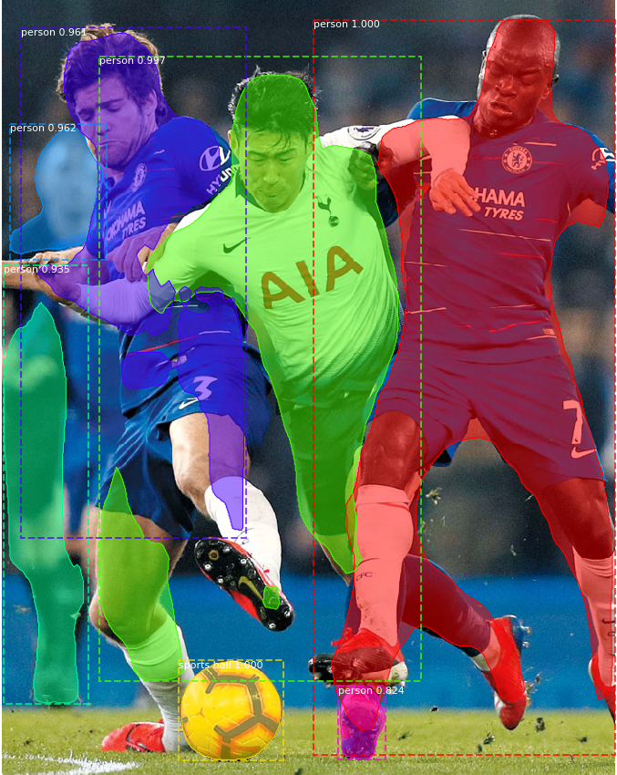
2
Progress
Test Result(Person)– Park Juhyeon
Bad case

Slide 31
2
Progress
Test Result(total)– Park Juhyeon
Conclusion
We need to more training using other datasets
Input image’s resolution is important

Slide 32
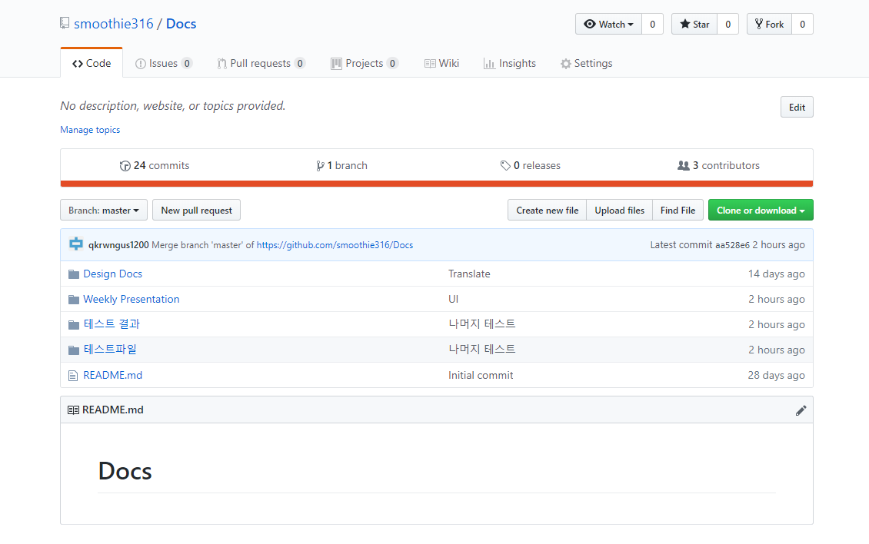
2
Progress
Test Result(total)– Park Juhyeon
Can see the details about test from our github(테스트 결과, 테스트 파일)
https://github.com/smoothie316/Docs

Slide 33
3.
Schedule

Slide 34
3
Schedule

Slide 35
3
Schedule
Progress | Park Juhyeon | Hong Jin | Heo Jung Woo
Already done | Content Acquisition & Data survey
 | Collect Initial Dataset
This Week Proceeding | Implement Learning Model | Basic Function & Keyword Recommendation | Basic UI & Design Basic Function`s Dialog
 | Collect Test Dataset
 | Test & Reviw Learning Model

Slide 36
4.
Q&A

